Slide 1
EXPLORING WORLDS TOP YOUTUBE CHANNEL
PROJECT REPORT

Slide 2
INTRODUCTION
1.1OVERVIEW
A Successful YouTube channel should include channel Name , consistent brand color ,captivating music sound effects ,and a catchy tagline
A subscribers to a channel on the video sharing YouTube is a user who has chosen to receive the channels content by clicking on that channel’s “ Subscribers “ button , and each subscribers feed consists of video published by channel to which the user is subscribed

Slide 3
1.2 Purpose
YouTube is the second largest search engine in the world so creating a YouTube channel is a fantastic way to enhance your conten’t visibility
YouTube can offer you a more intimate and engaging connection with your audience

Slide 4
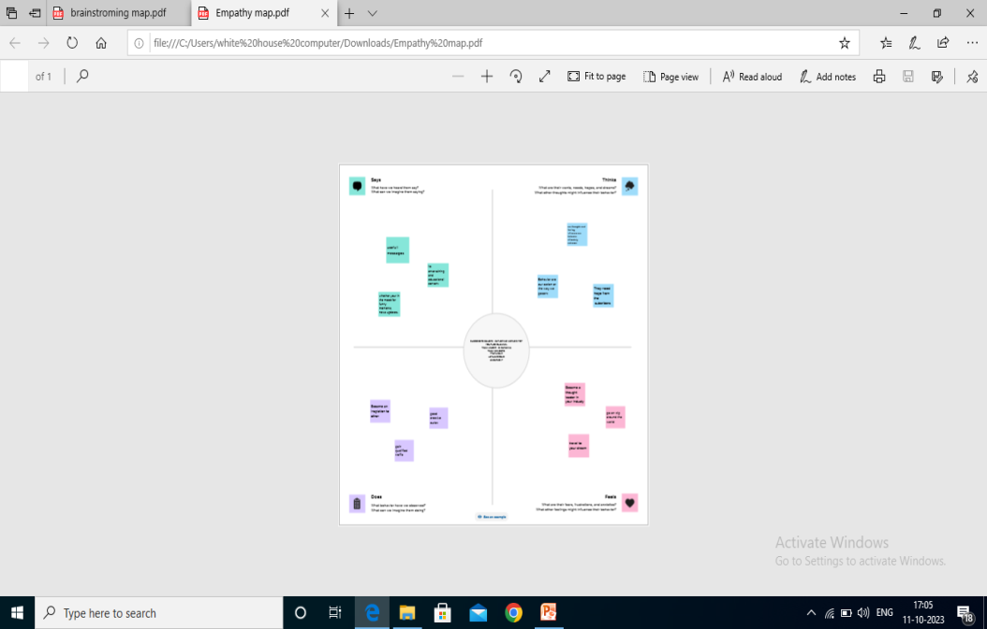
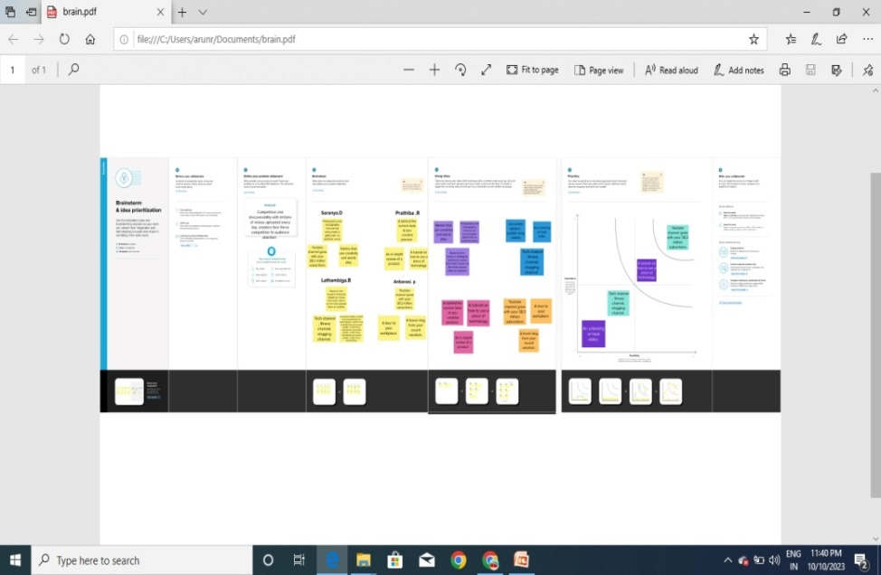
2.1 Empathy Map
2.2 Brain Storming Map

Slide 5
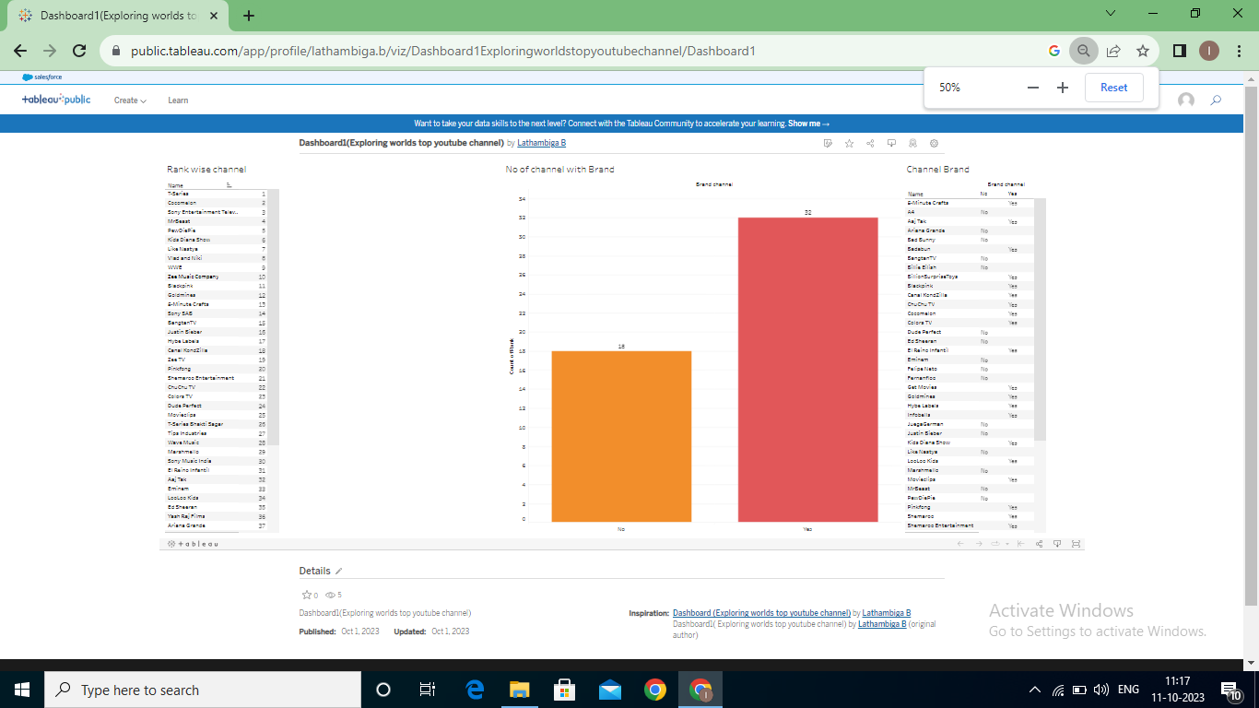
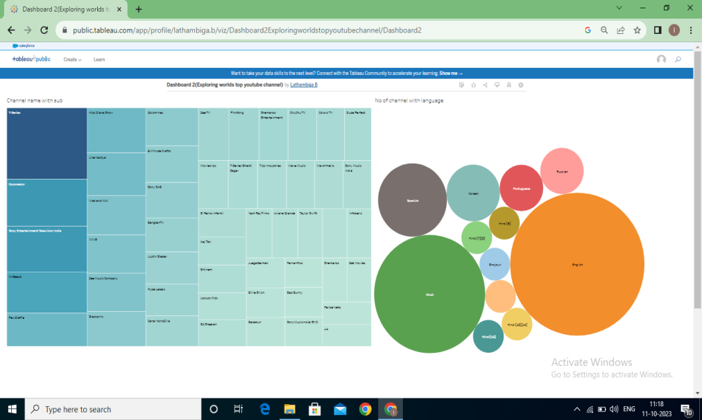
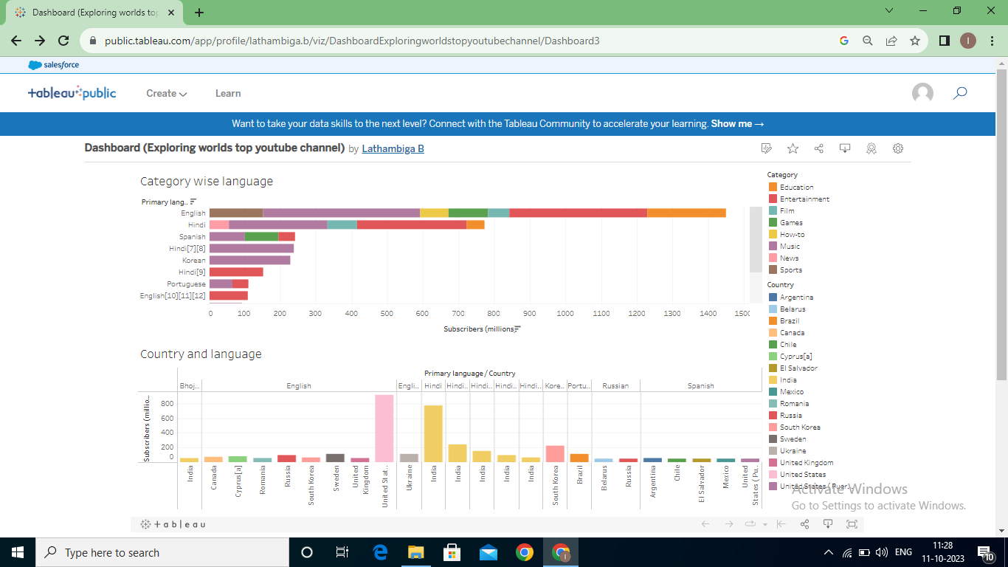
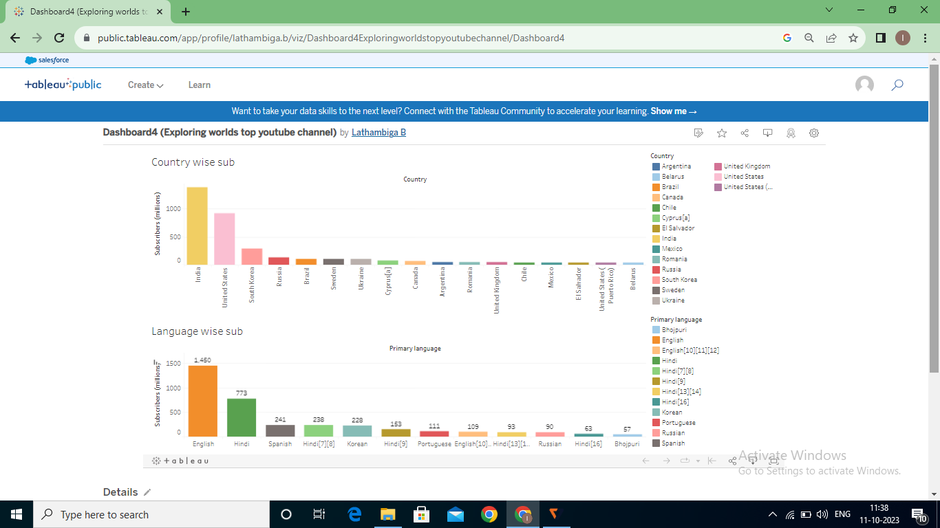
Result

Slide 6
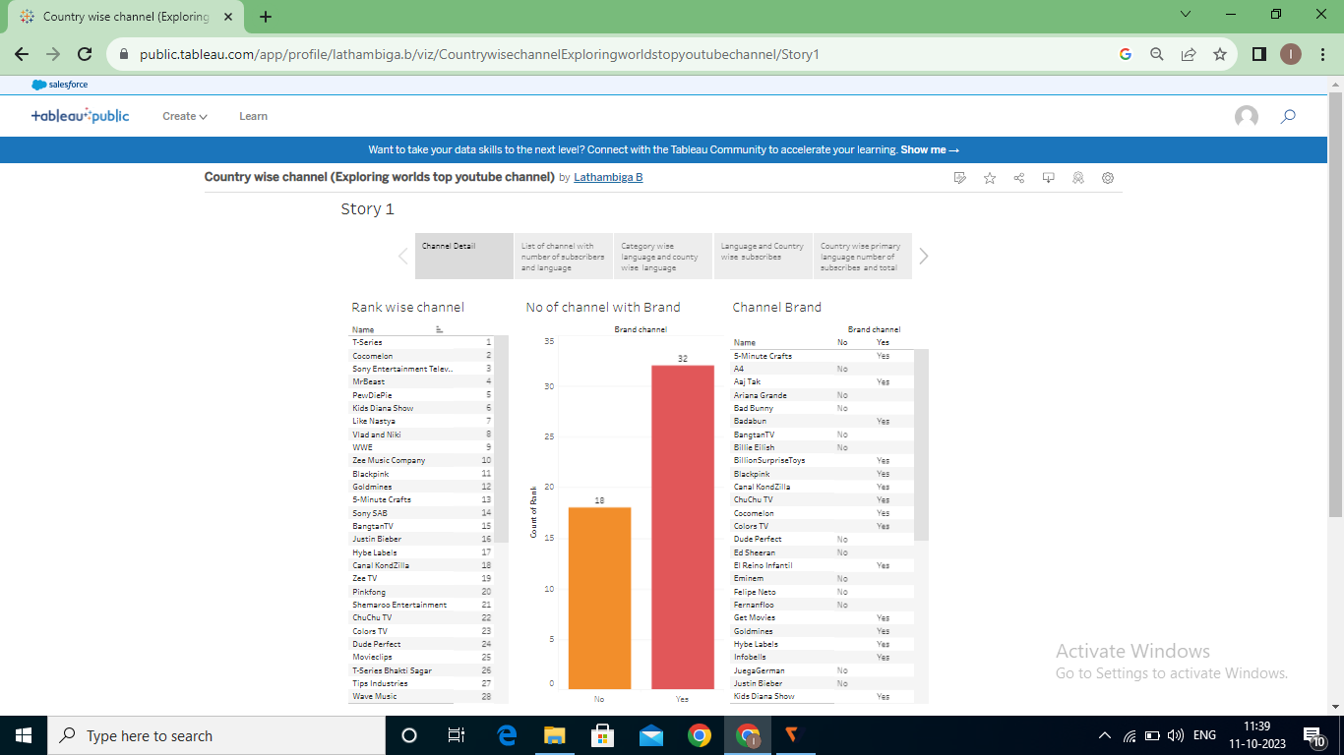

Slide 7
Advantages
Exposure to a world wide audience
Marketing on YouTube will help you
Gain qualified traffic
YouTube ads can reach even more people
YouTube as an information disseminating platform for students
A simple way to share
Give access to huge video content

Slide 8
Disadvantage
Some content has got paid access
A huge advertisement takes place
Pirated videos still operate on YouTube
There is no limit to view videos on YouTube
The app consume lot of data and uploading too might consume time as well
Earning money is difficult
Too much distraction

Slide 9
Conclusion
There are many positive aspects to keep in mind about YouTube in comparison to the negatives . By analyzing the positive and negatives of YouTube ,it is possible to get an idea of the number of users who receive the information and what percentage of them ae misleading

Slide 10
Future scope
Continued push towards AI and machine learning YouTube has been using AI and machine learning to improve the user experience, such as recommending videos and improving search result

